Slide 1
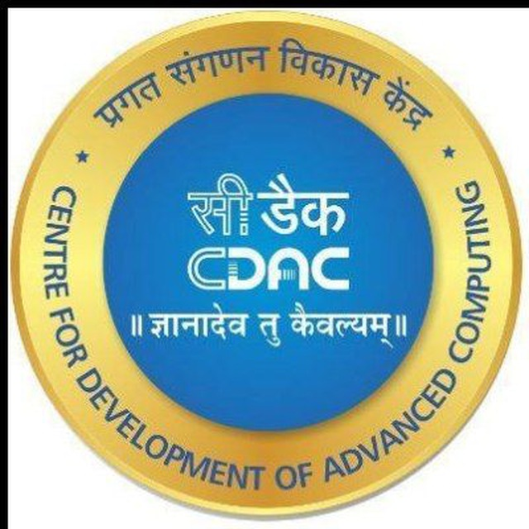
CDAC’s Centre For Development of Advance Computing C-DAC Mumbai, Mumbai 410210
<Farm Book>
Subject : Final Project
Presentation on Mini-Project (Day & Date: Saturday, 25th July 2022)
Presentation By Instructor
Sakshi Sharma (PL)
Rupesh Fuse Prof. Kiran Waghmare
Pankaj Lohar Dr. C.P. Johnson
Santosh Dound Director, CDAC (Mumbai)
Kundan Patil

Slide 2
Contents
Introduction
Modules
Features
Tools And Technologies
Advantages and Disadvantages
Conclusion

Slide 3
Introduction
We are Garuda , the eye that thinks, acts and enables.
Crafting human-centric technologies that lead to intelligence building & impact creation. Mining information dimensions that enable efficiencies and reduce redundancies, delivering analytics and insights that create large-scale impacts and propel overhauls is our mantle. We are a Drone-as-a-Service corporation .
We are built to scale

Slide 4
Modules
Admin:
Admin manager can add details .
Admin can add price and discount for the respective drone.
Admin can view booking done and the user details.

Slide 5
Modules
Users Login:
Check Drone: Users can check for drone of nearby locations and prices.
Check Availability: User can see the availability of the respective drone which is selected by him.
Book drone: User can provide the date, time and other personal details and he can also do the payment.
Wallet.
Money Transfer Between Accounts.

Slide 6
Features
Login: The manager can log in with the credentials provided by the user.
Check Rates: The manager can check rates for the respective location turf.
View Request: The manager can view the request for turf bookings.
Confirm Booking: Manager can confirm the booking of the turf.
Bill Generation: The manager can generate bills as per the rates.
Bookings History: Manager can check previous booking history.
.

Slide 7
Tools and Technologies
S/W Requirements :
Front-End : HTML, CSS, React, JavaScript
Back-End : Spring Security, Hibernate, Spring Boot
Database : MySQL
Server : Tomcat 9.0

Slide 8
Advantages & Disadvantages
Advantages
All Drones are available with specifications.
Drone booking can be done just by sitting at home.
Saves time (availability of all drone at a single platform).
Easy to access the system anywhere and anytime.
Disadvantages
It required only active internet connection.

Slide 9
Conclusion
We have plentiful evidence that drones are a useful - and increasingly widely used - technology for collecting spatial and operational data in support of humanitarian operations.
Twenty-six National Societies are using or plan to use drones, in a variety of ways. These use-cases include monitoring IDP camp construction; community mapping for resiliency projects; conducting search and rescue operations; post-disaster mapping after landslides and earthquakes; and capturing photographs and video for communications purposes. More use cases are likely to be added in the near future, as Societies grow more comfortable with drones and find new applications for the technology.

Slide 10
Thank You

